Slide 1
HEMODYNAMICS PRINCIPLES
-PRESSURE MEASUREMENT
-MEASUREMENT OF CARDIAC OUTPUT
Dr PRASANTH S
SR CARDIOLOGY

Slide 2
Pressure wave
A complex periodic fluctuation in force per unit area
A pressure wave is the cyclical force generated by cardiac muscle contraction
Its amplitude and duration are influenced by various mechanical and physiological parameters
  1 .force of the contracting chamber
  2.surrounding structures - contiguous chambers of the heart pericardium, lungs, vasculature
  3.Physiological variables - heart rate, respiratory cycle

Slide 3
Pressure Measurement
Terminology
Pressure wave: Complex periodic fluctuation in force per unit area
Fundamental frequency: number of times the pressure wave cycles in 1 second
Harmonic: multiple of fundamental frequency
Fourier analysis: resolution of any complex periodic wave into a series of simple sine waves of differing amplitude and frequency

Slide 4
Pressure Measurement
Terminology
Natural frequency
  Frequency at which fluid oscillates in a catheter when it is shock excited.
  Frequency of an input pressure wave at which the ratio of output/input amplitude of an undamped system is maximal
Natural
frequency
catheter
radius
=
x
1
Catheter length
fluid density x catheter compliance
SHORTER catheter
LARGER catheter lumen
HIGHER natural frequency
LIGHTER fluid
Baim DS and Grossman W. Cardiac Catheterization, Angiography, and Intervention. 8^{h} Edition. Baltimore: Williams and Wilkins, 2014

Slide 5
Pressure Measurement
Terminology
Damping
  Dissipation of the energy of oscillation of a pressure management system, due to friction
viscosity of fluid
Damping
α
catheter radius
GREATER fluid viscosity
SMALLER catheter radius
GREATER damping

Slide 6
Pressure Measurement
Harmonics- Wigger’s principle
Hemodynamic
Pressure Curve
Amplitude
1st Harmonic
Cycle
2nd Harmonic
3rd Harmonic
4th Harmonic
5th Harmonic
6th Harmonic
Notes:
Using Fourier analysis, the arterial waveform can be broken down into a fundamental frequency (the heart rate) and its harmonics. The arterial waveform can be reproduced from the first 7-10 harmonics. The arterial pressure undergoes a PHASE LAG and AMPLIFICATION as it propagates down the arterial system.

Slide 7
Pressure Measurement
Fourier analysis
Fourier found that each pressure wave is a summation of a series of simple sine waves of differing amplitude and frequency
Essential physiologic information is contained within the first 10 harmonics
  At a HR of 120, the fundamental frequency is 2 cycles/sec, and 10th harmonic is 20 cycles/sec. A pressure response system with a frequency response range that is flat to 20 cycles/sec will be adequate.
  Fidelity of the recording drops with increasing HR.
Wiggers CJ. The pressure pulses in the cardiovascular system. Longmans, green;1928

Slide 8
To record pressure accurately, a system must respond with equal amplitude for a given input throughout the range of frequencies contained within the pressure wave
If components in a particular frequency range are either suppressed or exaggerated by the transducer system, the recorded signal will be a grossly distorted version of the original physiologic waveform

Slide 9
Pressure Measurement
Hürthle Manometer
Rotating
smoked
drum
Frequency response profile
  Ratio of output amplitude to input amplitude over a range of frequencies of the input pressure
  Frequency response of a catheter system is dependent on catheter’s natural frequency
  and amount of damping
  The higher the natural
  frequency of the system,
  the more accurate the
  pressure measurement
  at lower physiologic
  frequencies
Amplifying
lever arm
Sensing
membrane
Fluid
filled
tubing

Slide 10
Pressure Measurement
Hürthle Manometer
Rotating
smoked
drum
Sensitivity
  Ratio of amplitude of the recorded
  signal to the amplitude of the input
  signal
Amplifying
lever arm
Sensing
membrane
Fluid
filled
tubing
Baim DS and Grossman W. Cardiac Catheterization, Angiography, and Intervention. 8th Edition. Baltimore: Williams and Wilkins, 2014

Slide 11
Pressure Measurement
Optimal Damping
D=0
(undamped)
D=0.20
(highly underdamped)
Amplitude Ratio (Output / Input)
D=0.64
(optimally
damped)
D=0.40
(underdamped)
D=2
(over
damped)
Input Frequency as Percent of Natural Frequency
Baim DS and Grossman W. Cardiac Catheterization, Angiography, and Intervention. 8^{h} Edition. Baltimore: Williams and Wilkins, 2014
.
Notes:
As driving frequency measured approaches natural frequency of the system, RESONANCE occurs and artifactually increases the measured amplitude. To avoid RESONANCE, the natural frequency of the system should be at least 3 times the frequency of the pressure of interest (10th harmonic of arterial pressure). As damping diminishes, the OVERSHOOT in system makes difficult the measurement of rapid alterations in pressure.

Slide 12
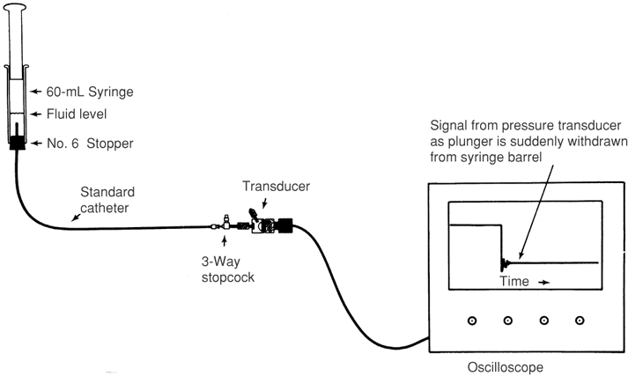
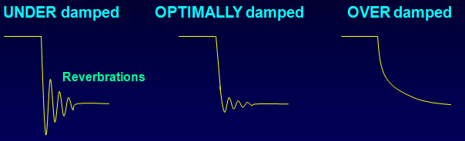
Evaluation of dynamic response characteristics of the catheter- transducer system

Slide 13
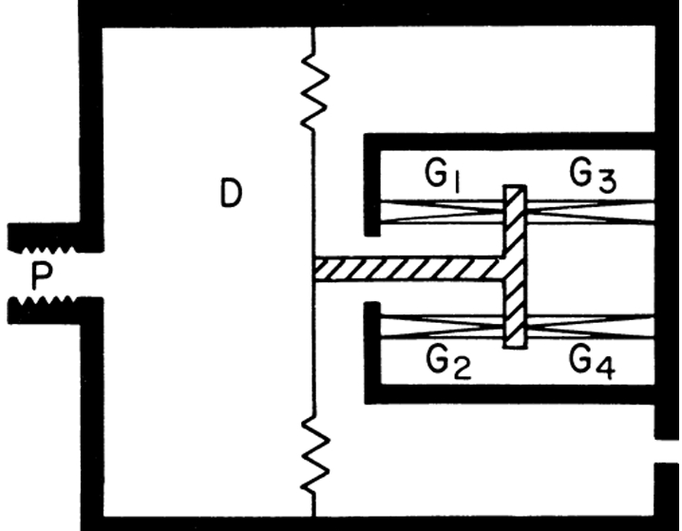
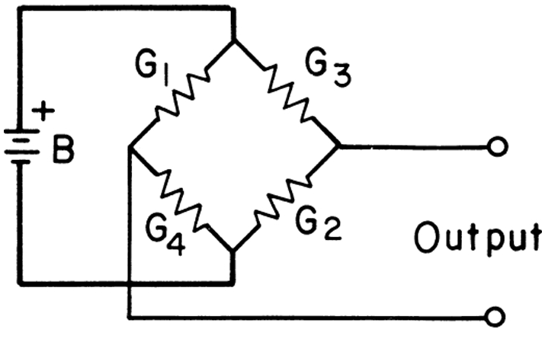
Transforming pressure wave to electrical signals
Strain gauge pressure transducer
Strain gauge connection of Wheatstone bridge

Slide 14
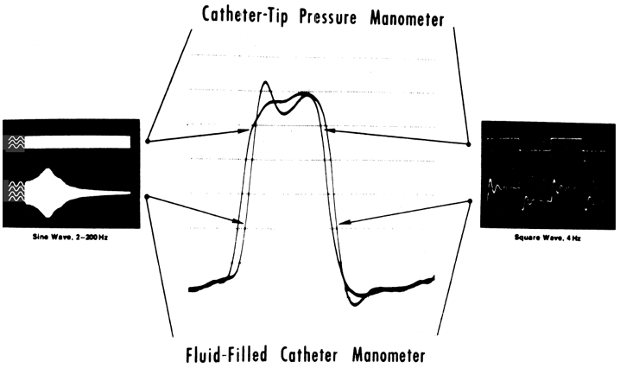
Pressure Measurement Systems
Fluid-filled Systems
Micromanometer Catheters

Slide 15
Fluid-filled Systems
fluid-filled catheter attached to a pressure transducer
pressure wave is transmitted by the fluid column within the catheter
Pressure measurement system should have the highest possible natural frequency and optimal damping
Data should be collected ,with the patient in steady state before introduction of radiographic contrast.
Accurate ‘zero’ reference is essential
Transducers must be calibrated frequently (before each recording)

Slide 16
The pressure transducer -calibrated against a known pressure and the establishment of a zero reference undertaken at the start of the catheterization procedure
To “zero” the transducer, the transducer is placed at the level of the atria, which is approximately midchest
If the transducer is attached to the manifold and is therefore at variable positions during the procedure, a second fluid-filled catheter system should be attached to the transducer and positioned at the level of the midchest

Slide 17
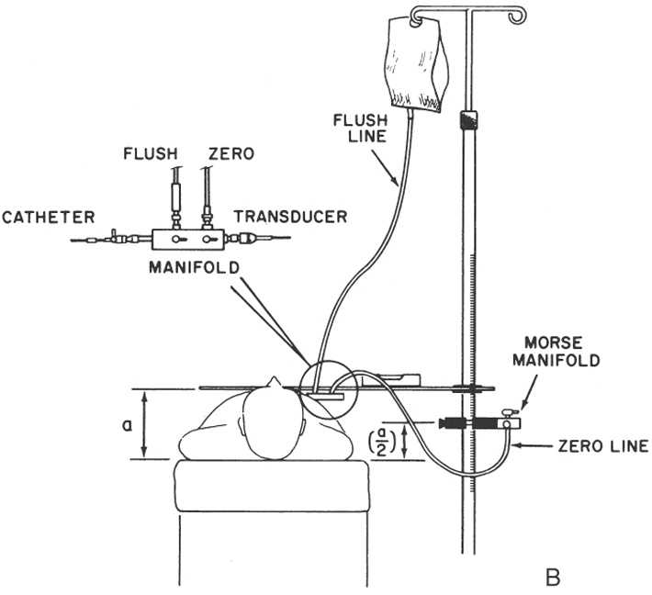
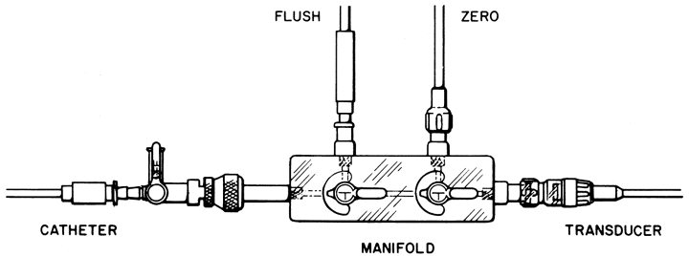

Slide 18
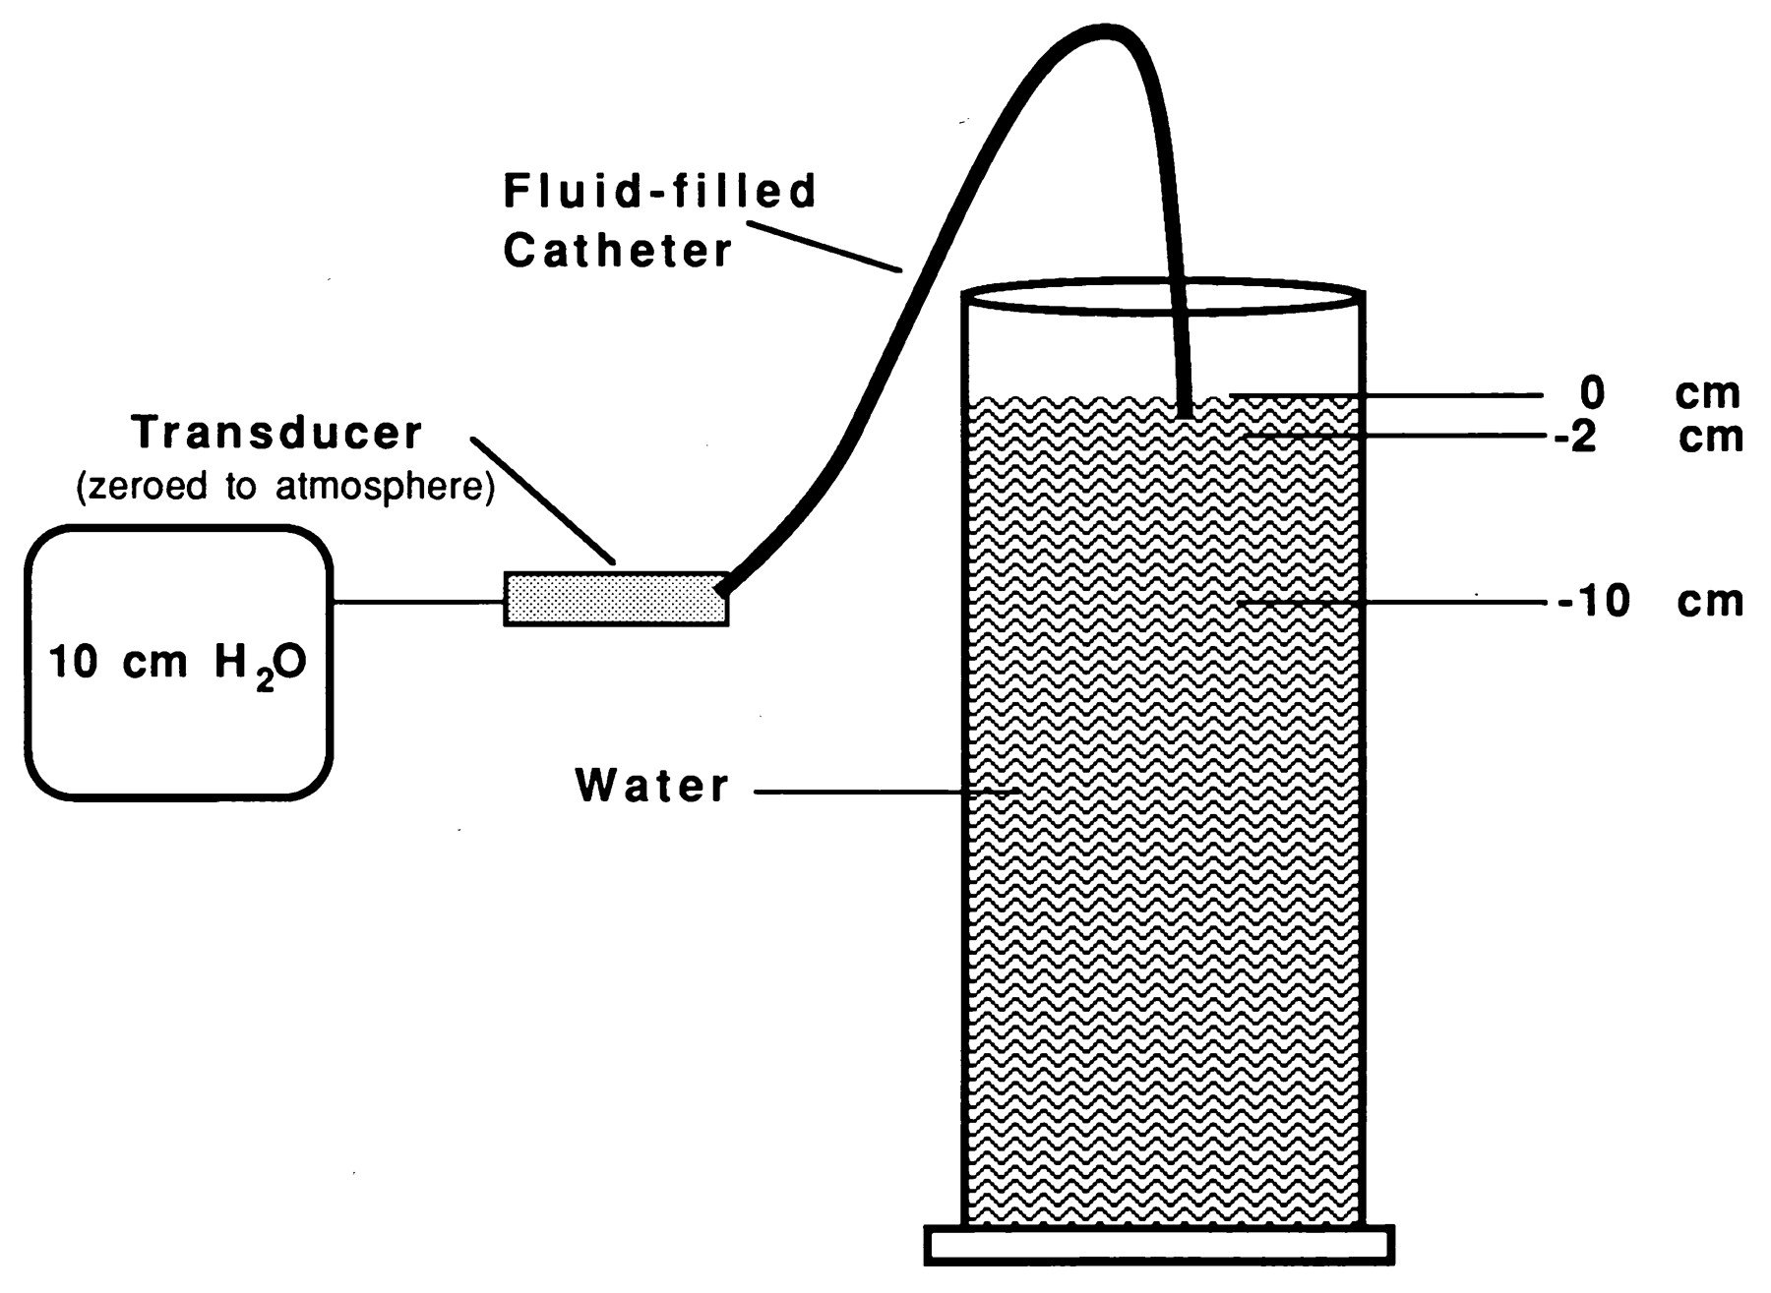

Schematic representation of hypothetical pressure measurement situation demonstrating the relation between transducer position relative to uppermost fluid level in a cylinder and measured hydrostatic pressure.
Michael Courtois et al. Circulation. 1995;92:1994-2000
Notes:
Schematic representation of hypothetical pressure measurement situation demonstrating the relation between transducer position relative to uppermost fluid level in a cylinder and measured hydrostatic pressure. Measured hydrostatic pressure with this configuration (in box) is 10 cm H₂O.

Slide 19
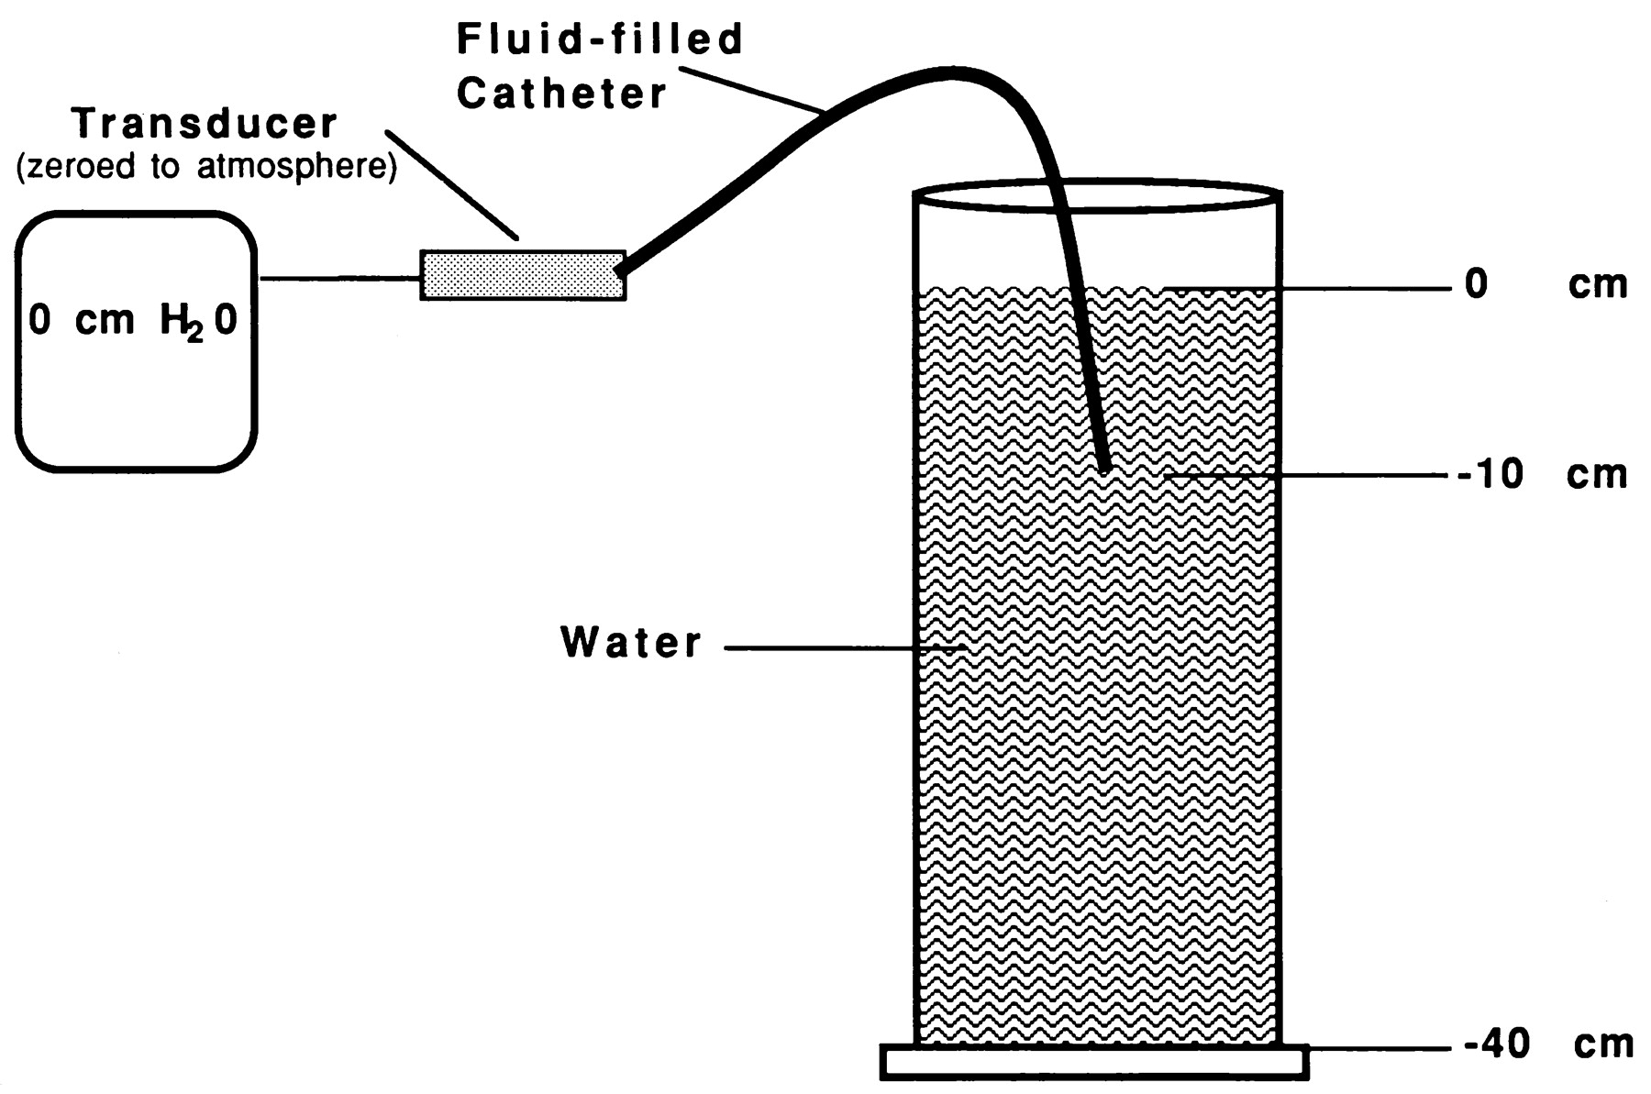
Schematic representation of hypothetical pressure measurement situation demonstrating the proposed pressure reference level for a fluid-filled catheter system that removes all hydrostatic influences due to the height of fluid within a vessel or chamber in which pressure is being measured.
Michael Courtois et al. Circulation. 1995;92:1994-2000
Notes:
Schematic representation of hypothetical pressure measurement situation demonstrating the proposed pressure reference level for a fluid-filled catheter system that removes all hydrostatic influences due to the height of fluid within a vessel or chamber in which pressure is being measured. Alignment of the external transducer with the uppermost fluid level yields a reading of zero hydrostatic pressure independent of catheter position within the vessel.

Slide 20
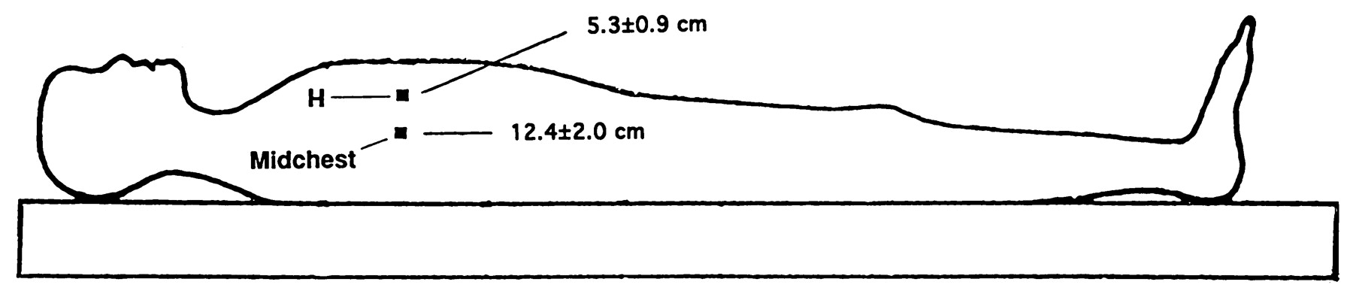
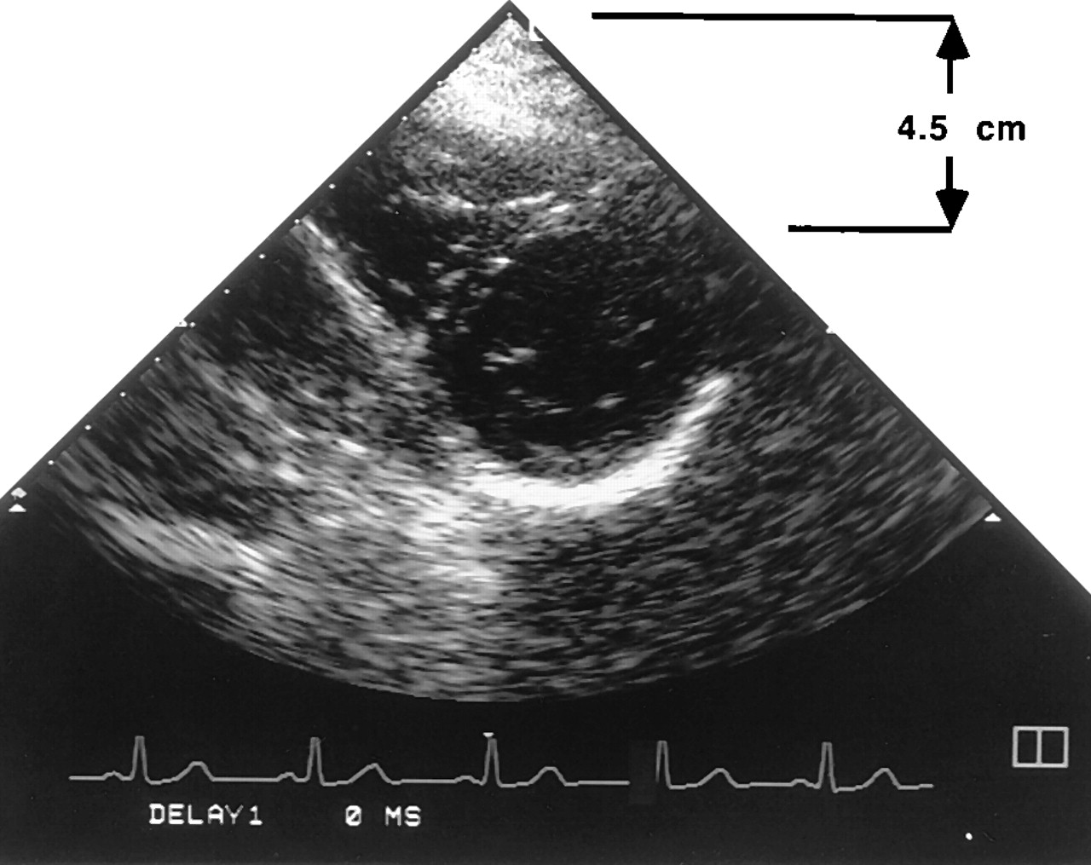
Schematic representation of measured heights for an external fluid-filled transducer reference position relative to the anterior chest wall at a midchest level and at the uppermost blood level (H) in the left ventricle in seven patients.
Michael Courtois et al. Circulation. 1995;92:1994-2000
Notes:
Schematic representation of measured heights for an external fluid-filled transducer reference position relative to the anterior chest wall at a midchest level and at the uppermost blood level (H) in the left ventricle in seven patients.

Slide 21
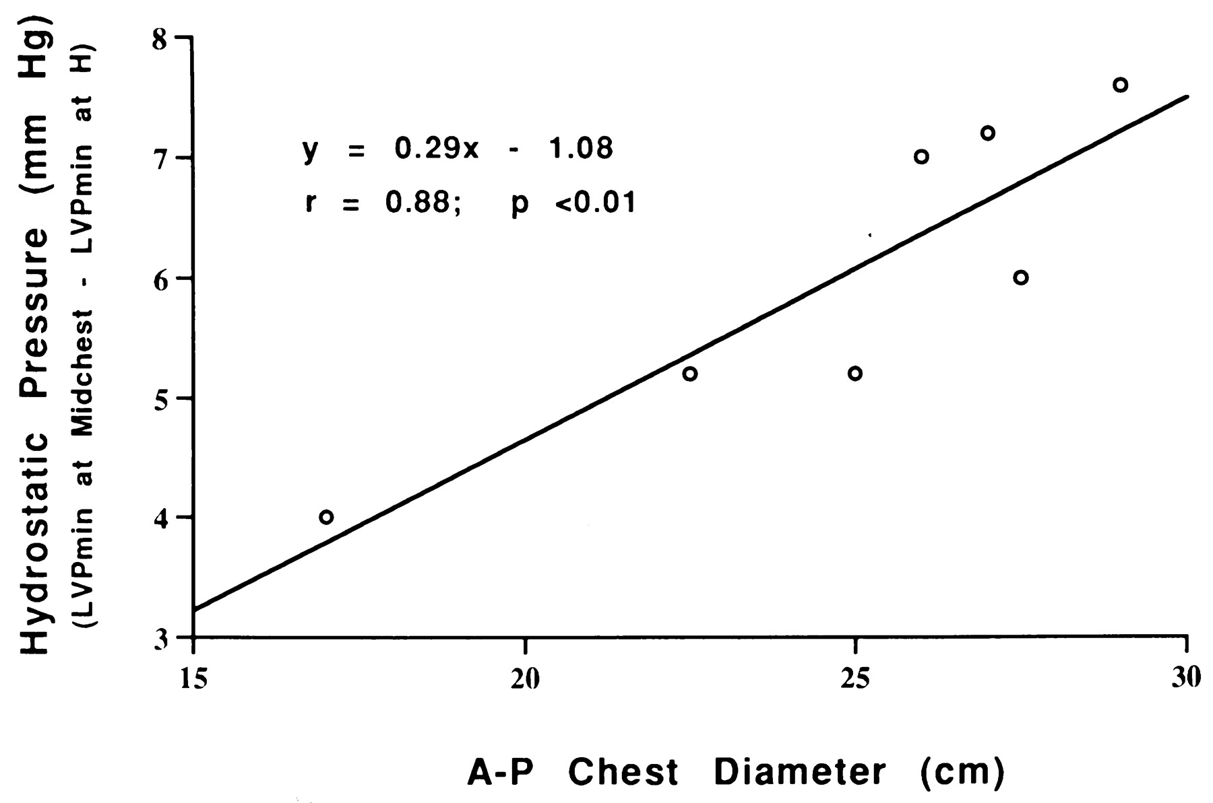
Graph showing minimum left ventricular pressure (LVPmin) measurement error due to hydrostatic pressure influences attributable to a midchest reference position as a function of patient anterior-posterior (A-P) chest thickness.
Michael Courtois et al. Circulation. 1995;92:1994-2000
Notes:
Graph showing minimum left ventricular pressure (LVP_{min}) measurement error due to hydrostatic pressure influences attributable to a midchest reference position as a function of patient anterior-posterior (A-P) chest thickness. H indicates measurement taken at the uppermost blood level in the left ventricle.

Slide 22
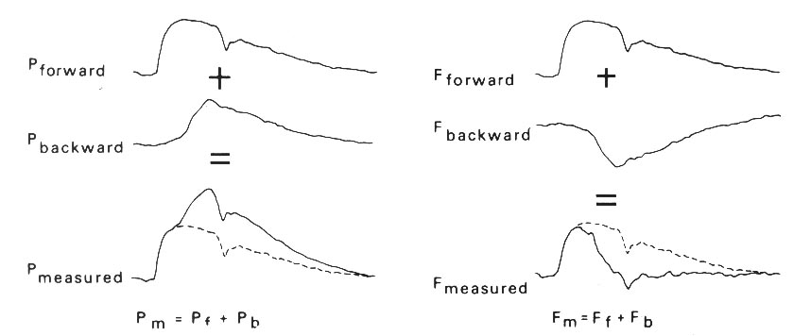
Physiologic characteristics
Reflected Waves
Reflected waves: Both pressure and flow at any given location are the geometric sum of the forward and backward waves
Baim DS and Grossman W. Cardiac Catheterization, Angiography, and Intervention. 8th Edition. Baltimore: Williams and Wilkins, 2014
.

Slide 23
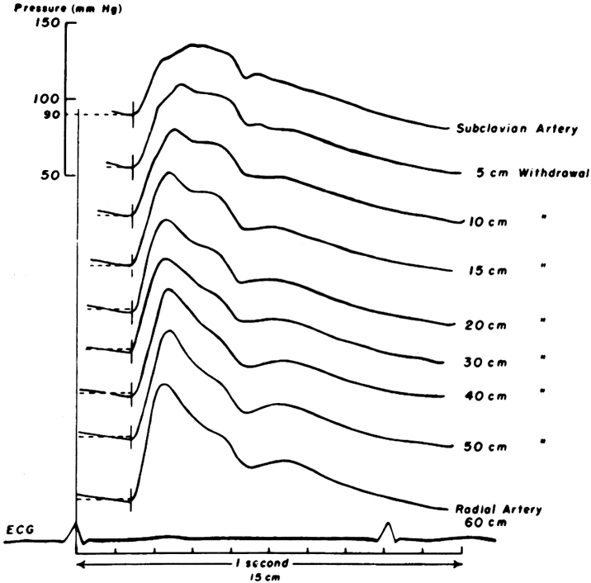
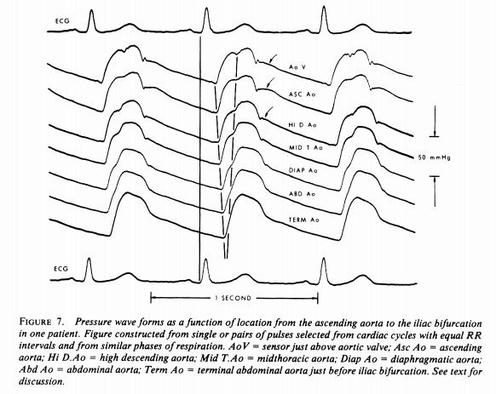
INPUT IMPEDANCE AND PRESSURE WAVE FORMS;Murgo et al.circulation 1980

Slide 24
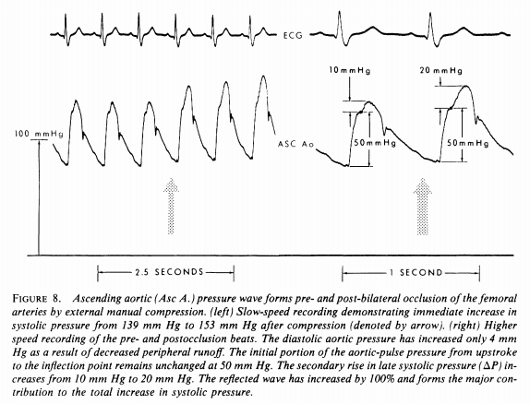
INPUT IMPEDANCE AND PRESSURE WAVE FORMS;Murgo et al.circulation 1980

Slide 25
Physiologic characteristics
Reflected Waves
Augmented pressure wave reflections
  Vasoconstriction
  Heart failure
  Hypertension
  Aortic / iliofemoral obstruction
  Post-valsalva release
Diminished pressure wave reflections
  Vasodilation (physiologic / pharmacologic)
  Hypovolemia
  Hypotension
  Valsalva maneuver strain phase
Baim DS and Grossman W. Cardiac Catheterization, Angiography, and Intervention. 8th Edition. Baltimore: Williams and Wilkins, 2014

Slide 26
Physiologic characteristics
Wedge Pressure
Wedge Pressure
  Pressure obtained when an end-hole catheter is positioned in a “designated” blood vessel with its open end-hole facing a capillary bed, with no connecting vessels conducting flow into or away from the “designated” blood vessel between the catheter’s tip and the capillary bed
  True wedge pressure can be measured only in the absence of flow, allowing pressure to equilibrate across the capillary bed
Baim DS and Grossman W. Cardiac Catheterization, Angiography, and Intervention. 8th Edition. Baltimore: Williams and Wilkins, 2014

Slide 27
ERROR & ARTIFACT
DETERIORATION OF FREQUENCY RESPONSE
  Introduction of air permits damping and reduces natural frequency by serving as added compliance.
  When natural frequency of pressure system falls, high frequency components of the pressure waveform (intraventricular pressure rise and fall) may set the system into oscillation, producing “pressure overshoots” ( early systole & diastole of ventricular pressure curve).
  Flushing-restores the frequency response of system.

Slide 28
Artifacts
Movement artifact (WHIP Artifact)
Motion of tip of the catheter within the measured chamber
→ Enhance the fluid oscillations of the transducer system
May produce superimposed waves of ±10 mm Hg
Particularly common in PA
  Render systolic and to a lesser extent diastolic pressures unreliable.
  No way to fix it internally.
  Stabilize externally.
  If whip noted -consider using mean pressures. (usually not affected)

Slide 29
Artifacts
End pressure artifact
  An end-hole catheter measures an artificially elevated pressure
  because of streaming or high velocity of the pressure wave
  Flowing blood- sudden halt- K E is converted to pressure
  This added pressure may range from 2-10 mm Hg
Catheter impact artifact
  When the catheter is struck by the walls or valves of the cardiac chambers.
  Common with the pigtail catheter in the LV, where the MV hits the catheter as they open in early diastole

Slide 30
Systolic Presure amplification in the periphery
Peak SBP in radial,brachial,femoral > peak SBP in central Aorta -20 mmHg
Mean arterial Pr remains same.
Largely as a consequence of reflected wave from Aortic bifurcation, arterial branching, small peripheral vessels
Reinforce the peak and trough of the anterograde Pressure wave
  Masks pressure gradients in LV or across aortic valve

Slide 31
Micromanometer –Tipped Catheters
Fluid filled system-distortion of wave forms- artifacts, amplification of systolic pressure in periphery, damping or augmentation of frequency response system.
For precise,undistorted ,high fidelity pressure recordings
Micromamometer chips at the end of catheters
Interposing fluid column is eliminated
Have higher natural frequencies and more optimal damping characteristics
To assess pressure waveform contours in a tachycardia situation, rate of ventricular pressure rise(dp/dt) etc
Limitation- additional cost, fragility , time needed for properly calibrating and using the system

Slide 32
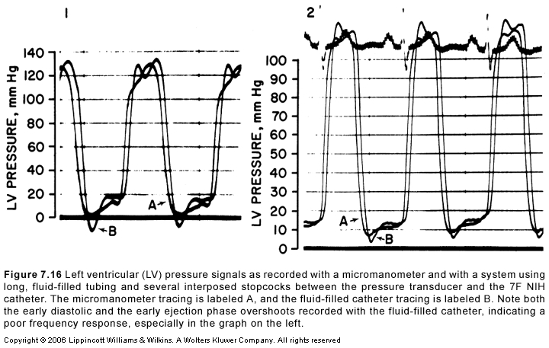
Micromanometer
Micromanometer

Slide 33
Frequency response

Slide 34
Hemodynamic Parameters
Reference Values
Average
Range
Average
Range
Right atrium
PCWP
a wave
6
2 - 7
mean
9
4 - 12
v wave
5
2 - 7
Left atrium
mean
3
1 - 5
a wave
10
4 - 16
Right ventricle
v wave
12
6 - 21
peak systolic
25
15 - 30
mean
8
2 - 12
end diastolic
4
1 - 7
Left ventricle
Pulmonary artery
peak systolic
130
90 - 140
peak systolic
25
15-30
end diastolic
8
5 - 12
end diastolic
9
4-12
Central aorta
mean
15
9-19
peak systolic
130
90 - 140
end diastolic
70
60 - 90
mean
85
70 -105
Davidson CJ, et al. Cardiac Catheterization. In: Heart Disease: A Textbook of Cardiovascular Medicine,
Edited by E. Braunwald

Slide 35
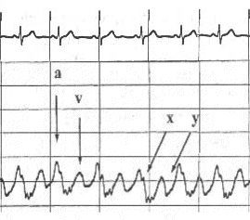
Right Heart Catheterization
Right Atrial Pressure
“a” wave
  Atrial systole
“c” wave
  Protrusion of TV into RA
“a” wave
  Atrial systole
“c” wave
  Protrusion of TV into RA
“x” descent
  Relaxation of RA
  Downward pulling of tricuspid
  annulus by RV contraction
“v” wave
  RV contraction
  Height related to atrial compliance & amount of blood return
  Smaller than a wave
“a” wave
  Atrial systole
“c” wave
  Protrusion of TV into RA
“x” descent
  Relaxation of RA
  Downward pulling of tricuspid
  annulus by RV contraction
“v” wave
  RV contraction
  Height related to atrial compliance & amount of blood return
  Smaller than a wave
“y” descent
  TV opening and RA emptying into RV
“a” wave
  Atrial systole
“c” wave
  Protrusion of TV into RA
“x” descent
  Relaxation of RA
  Downward pulling of tricuspid
  annulus by RV contraction

Slide 36
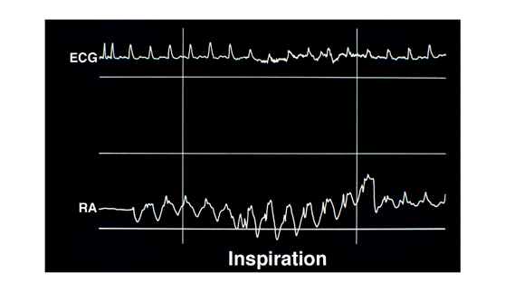
Right Heart Catheterization
Inspiratory Effect on Right Atrial Pressure
Normal physiology
  Inhalation: Intrathoracic pressure falls → RA pressure falls
  Exhalation: Intrathoracic pressure increases → RA pressure increases
Kern MJ. Right Heart Catheterization. CATHSAP II CD-ROM. Bethesda, American College of Cardiology, 2001.

Slide 37
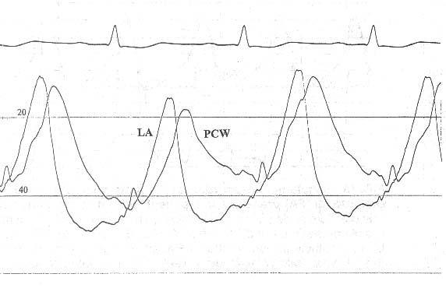
Right Heart Catheterization
Left Atrial and PCW Pressure
PCW tracing “approximates” actual LA tracing but is slightly delayed since pressure wave is transmitted retrograde through pulmonary veins
Baim DS and Grossman W. Cardiac Catheterization, Angiography, and Intervention. 5th Edition. Baltimore: Williams and Wilkins, 1996.

Slide 38
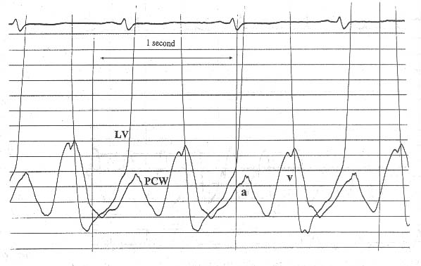
Left Heart Catheterization
Left Ventricular Diastole
MV
opens
MV
closes
S1
y
x
Davidson CJ, et al. Cardiac Catheterization. In: Heart Disease: A Textbook of Cardiovascular Medicine,
Edited by E. Braunwald, 5th ed. Philadelphia: WB Saunders Company, 1997

Slide 39
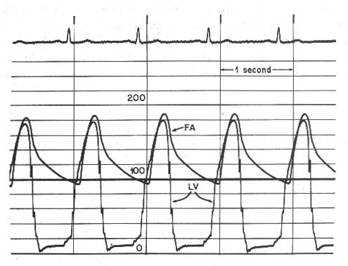
Left Heart Catheterization
Left Ventricular Systole
AoV
closes
AoV
opens
S2
Davidson CJ, et al. Cardiac Catheterization. In: Heart Disease: A Textbook of Cardiovascular Medicine,
Edited by E. Braunwald, 5th ed. Philadelphia: WB Saunders Company, 1997

Slide 40
Cardiac output measurement

Slide 41
Cardiac Output
Definition: Quantity of blood delivered to the systemic circulation per unit time expressed in L/min
Techniques of measurement:
  Fick-Oxygen Method
  Indicator-Dilution Methods
    Indocyanine Green
    Thermodilution

Slide 42
Extraction reserve and CO
The extraction of a particular nutrient expressed as A-V difference across that tissue.
The factor by which the arteriovenous difference can increase at constant cardiac output, owing to changes in metabolic demand, termed as extraction reserve.
Normal extraction reserve for O₂- 3. ie, under extreme metabolic demand, tissues can extract upto 120ml of O₂(40×3) from each liter of blood delivered.

Slide 43
As the cardiac output falls, extraction of O₂ by the tissues increases. Upto 1/3 fall in C.O can be compensated by 3 times increase in extraction reserve.
C.O below one third of normal- incompatible with life (CI ≤ 1.0 L/min/m²).
Upper limit of C.O in trained athletes- 600% of resting output.
under extreme exercise, total body O₂ requirement increases to 18 times, which is met by 6 fold rise in C.O and 3 fold rise in extraction reserve

Slide 44
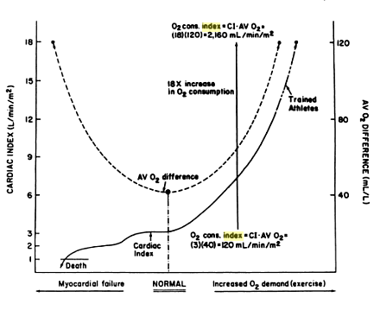
Relationship of arteriovenous oxygen difference and cardiac index

Slide 45
Cardiac Output Measurement
Fick Oxygen Method
Fick Principle: The total uptake or release of any substance by an organ is the product of blood flow to the organ and the arteriovenous concentration difference of the substance.
As applied to lungs, the substance released to the blood is oxygen, oxygen consumption is the product of arteriovenous difference of oxygen across the lungs and pulmonary blood flow.
In the absence of a shunt, systemic blood flow (Qs) is estimated by pulmonary blood flow (Qp).
Oxygen consumption
Q =
Arteriovenous O₂ difference

Slide 46
Oxygen consumption
Uptake of oxygen from room air by the lungs is measured.
Douglas bag method
The polarographic method
The paramagnetic method

Slide 47
Polarographic method
Douglas bag method
Metabolic rate meter by Waters instruments
Parts: oxygen hood /mask
Polarographic oxygen sensor cell
V o2=O2 content in the room air – O2 content in the air flowing past the polarographic cell
Respiratory quotient is assumed
Paramagnetic method
Paramagnetic sensor for measuring O2
Adjusts for temperature and partial pressure of water vapour
Calculates respiratory Q for each patient
Older
A timed sample of patients expired air is collected in a Douglas bag & analyzed for O2 content and ( Beckman oxygen analyzer) and volume
O2 content of room air is also measured
Oxygen consumption per l per minute is calculated

Slide 48
Cardiac Output Measurement
Fick Oxygen Method: O₂ Consumption
Douglas Bag Method
  Volumetric technique for measuring O2
  Analyzes the collection of expired air
  Utilizes a special mouthpiece and nose clip so that patient breathes only through mouth
  A 2-way valve permits entry of room air while causing all expired air to be collected in the Douglas bag
  Volume of air expired in a timed sample (3 min) is measured with a Tissot spirometer
Baim DS and Grossman W. Cardiac Catheterization, Angiography, and Intervention. 5th Edition. Baltimore: Williams and Wilkins, 1996.

Slide 49
Cardiac Output Measurement
Fick Oxygen Method: O₂ Consumption
Douglas Bag Method
Step 1: Calculate oxygen difference
pO₂ room air x 100
O₂ content room air =
Corrected barometric pressure
pO₂ expired air x 100
O₂ content expired air =
Corrected barometric pressure
Oxygen difference =
O₂ room air - O₂ expired air = ______ mL O₂ consumed / L air
Baim DS and Grossman W. Cardiac Catheterization, Angiography, and Intervention. 5th Edition. Baltimore: Williams and Wilkins, 1996.

Slide 50
Cardiac Output Measurement
Fick Oxygen Method: O₂ Consumption
Douglas Bag Method
Step 2: Calculate minute ventilation
Tissot difference = Tissot initial – Tissot final = _____ cm
Tissot volume = Tissot difference x correction factor = _____ L
Total volume = Tissot volume + sample volume = _____ L
Ventilation volume =
Total volume expired air x correction factor = _____ L
Ventilation volume
Minute ventilation =
Collection time
Baim DS and Grossman W. Cardiac Catheterization, Angiography, and Intervention. 5th Edition. Baltimore: Williams and Wilkins, 1996.

Slide 51
Cardiac Output Measurement
Fick Oxygen Method: O₂ Consumption
Douglas Bag Method
Step 3: Calculate oxygen consumption
O₂ consumption = O₂ difference x minute ventilation
O₂ consumption
O₂ consumption index =
Body surface area
Baim DS and Grossman W. Cardiac Catheterization, Angiography, and Intervention. 5th Edition. Baltimore: Williams and Wilkins, 1996.

Slide 52
Cardiac Output Measurement
Fick Oxygen Method: O₂ Consumption
Polarographic O₂ Method
  Metabolic rate meter
  Device contains a polarographic oxygen sensor cell, a hood and a blower of variable speed connected to the oxygen sensor.
  The MRM adjusts the variable-speed blower to maintain a unidirectional flow of air from the room through the hood and via a connecting hose to the polarographic oxygen-sensing cell.
.

Slide 53
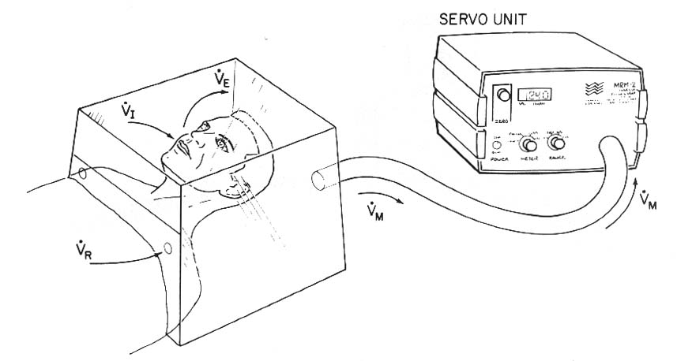
Cardiac Output Measurement
Fick Oxygen Method: O₂ Consumption
Polarographic O₂ Method
V_{M} = V_{R} + V_{E} - V_{I}
V_{E}
V_{M} = Blower Discharge Rate
V_{I}
V_{R} = Room Air Entry Rate
V_{I} = Patient Inhalation Rate
V_{R}
V_{M}
V_{E} = Patient Exhalation Rate
V_{O2} = (F_{R}O₂ x V_{R}) - (F_{M}O₂ x V_{M})
F_{R}O₂ = Fractional room air O2 content = 0.209
F_{M}O₂ = Fractional content of O2 flowing past polarographic cell
Baim DS and Grossman W. Cardiac Catheterization, Angiography, and Intervention. 5th Edition. Baltimore: Williams and Wilkins, 1996.

Slide 54
Cardiac Output Measurement
Fick Oxygen Method: O₂ Consumption
Polarographic O₂ Method
Constant if steady state
V_{O2} = (F_{R}O₂ x V_{R}) - (F_{M}O₂ x V_{M})
V_{O2} = V_{M} (0.209 - F_{M}O₂) + 0.209 (V_{I} - V_{E})
Servocontrolled system adjusts VM to keep fractional O2 content of air moving past polarographic sensor (FMO2) at 0.199
Respiratory quotient
RQ = V_{I} / V_{E} = 1.0
V_{O2} = 0.01 (V_{M}) + 0.209 (V_{I} - V_{E})
V_{O2} = 0.01 (V_{M})
Baim DS and Grossman W. Cardiac Catheterization, Angiography, and Intervention. 5th Edition. Baltimore: Williams and Wilkins, 1996.

Slide 55
Cardiac Output Measurement
Fick Oxygen Method: A V O₂ difference
Sampling technique
  Mixed venous sample
    Collect from pulmonary artery
    Collection from more proximal site may result in error with left-right shunting
  Arterial sample
    Ideal source: pulmonary vein
    Alternative sites: LV, peripheral arterial
      If arterial desaturation (SaO2 < 95%) present, right-to-left shunt must be excluded
Measurement
  Reflectance (spectophotometric analysis ) oximetry

Slide 56
Cardiac Output Measurement
Fick Oxygen Method: AV O₂ Difference
Step 1: Theoretical oxygen carrying capacity
O₂ carrying capacity (mL O₂ / L blood) =
1.36 mL O₂ / gm Hgb x 10 mL/dL x Hgb (gm/dL)
Step 2: Determine arterial oxygen content
Arterial O₂ content = Arterial saturation x O₂ carrying capacity
Step 3: Determine mixed venous oxygen content
Mixed venous O₂ content = MV saturation x O₂ carrying capacity
Step 3: Determine A-V O₂ oxygen difference
AV O₂ difference = Arterial O2 content - Mixed venous O₂ content
Baim DS and Grossman W. Cardiac Catheterization, Angiography, and Intervention. 8th Edition. Baltimore: Williams and Wilkins, 2014

Slide 57
Cardiac Output Measurement
Fick Oxygen Method
Fick oxygen method total error ≈ 10%
  Error in O2 consumption ≈ 6%
  Error in AV O2 difference ≈ 5%. Narrow AV O2 differences more subject to error, and therefore Fick method is most accurate in low cardiac output states
Sources of Error
  Incomplete collection of expired air (Douglas bag)
    Underestimate O2 consumption and CO
  Respiratory quotient = 1
    Volume of CO2 expired is not equal to O2 inspired
    Leads to underestimation of O2 consumption and CO
  Incorrect timing of expired air collection (Douglas bag)

Slide 58
Cardiac Output Measurement
Fick Oxygen Method
Sources of Error
  Spectophotometric determination of blood oxygen saturation
  Changes in mean pulmonary volume
    Douglas bag and MRM measure amount of O2 entering lungs, not actual oxygen consumption
    Patient may progressively increase or decrease pulmonary volume during sample collection. If patient relaxes and breathes smaller volumes, CO is underestimated
  Improper collection of mixed venous blood sample
    Contamination with PCW blood
    Sampling from more proximal site

Slide 59
Does VO₂ actually need to be measured?
Technical difficulties, expense
Assumption that O₂ consumption can be predicted from BSA.
Resting O₂ consumption- 125 ml/m² or 110 ml/m² for elderly patients.
180 pts; VO₂= CO(indicator dilution technique)
126±26 ml/mt/m²
Large discrepancies + direct measurement vs assumed values of O₂ consumption(>half the pts differing by >± 10%- kendrick et al; UK; EHJ 1988)
A V oxygen difference
Dehmer et al;oxygen consumption in adult patients during cardiac catheterisation;clin cardiology 1982

Slide 60
Cardiac Output Measurement
Indicator Dilution Method- ‘Stewart’
Requirements
  Bolus of indicator substance(non toxic) which mixes completely with blood and whose concentration can be measured
  Indicator is neither added nor subtracted from blood during passage between injection and sampling sites
  Most of sample must pass the sampling site before recirculation occurs
  Indicator must go through a portion of circulation where all the blood of the body becomes mixed

Slide 61
Cardiac Output Measurement
Indicator Dilution Methods
Stewart-Hamilton Equation
Indicator amount
C = concentration
of indicator
CO =
∞
C (t) dt
⎧
⎭
0
Indicator amount (mg) x 60 sec
CO =
mean indicator concentration (mg/mL) x curve duration
Indicators
  Indocyanine Green
  Thermodilution (Indicator = Cold)

Slide 62
Cardiac Output Measurement
Indocyanine Green Method
Indocyanine green (volume and concentration fixed) injected as a bolus into right side of circulation (pulmonary artery)
Samples taken from peripheral artery, withdrawing continuously at a fixed rate
Indocyanine green concentration measured by densitometry
CO inversely proportional
to area under
curve
I
CO =
Recirculation
(C x t )
Concentration
Extrapolation
of plot
(C x t)
time

Slide 63
time of passage (Δt) = 0.5 min
~
average conc (X) = 2 mg/L
Amount of dye added = 5 mg
Average dye concentration = 2 mg/L
Therefore the volume that diluted the dye =
5mg/2mg per L = 2.5 L
Time took to go past = 0.5 min
ie flow rate = 2.5 L /0.5 min = 5 L/min
General equation:
mass of dye (Q g)
Flow rate =
~
average dye conc (X g/L) x time of passage (Δt min)

Slide 64
Cardiac Output Measurement
Indocyanine Green Method
Sources of Error
  Indocyanine green unstable over time and with exposure to light
  Sample must be introduced rapidly as single bolus
  Indicator must mix thoroughly with blood, and should be injected just proximal or into cardiac chamber
  Dilution curve must have exponential downslope of sufficient length to extrapolate curve.
  Invalid in Low cardiac output states and shunts that lead to early recirculation
  Withdrawal rate of arterial sample must be constant

Slide 65
Thermodilution Method
Fegler 1954 (CONSERVATION OF ENERGY)
cold saline or 5% D
balloon-tipped flow-directed pvc catheter
thermistor at tip
opening 25 to 30 cm proximal to the tip
Via vein to PA (proximal opening –SVC or RA, thermistor –PA)
5 to 10 mL to proximal port
change in temperature at the thermistor recorded

Slide 66
Cardiac Output Measurement
Thermodilution Method
V_{I} (T_{B}-T_{I}) (S_{I} x C_{I} / S_{B} x C_{B} ) x 60 ×0.825
CO =
∞
⎧
Δ T_{B} dt
⎭
0
V_{I} = volume of injectate
S_{I}, S_{B} = specific gravity of injectate and blood
C_{I}, C_{B} = specific heat of injectate and blood
T_{I} = temperature of injectate
Δ T_{B} = change in temperature measured downstream
0.825-correction factor for warming of injectate from the syringe or by catheter

Slide 67
Cardiac Output Measurement
Thermodilution Method
Advantages over indocyanine green dye method
  Withdrawal of blood not necessary
  Arterial puncture not required
  Indicator (saline or D5W)- inert and inexpensive.
  Virtually no recirculation, simplifying computer analysis of primary curve sample

Slide 68
Cardiac Output Measurement
Thermodilution Method
Sources of Error (± 15%)
  Unreliable in tricuspid regurgitation
  Baseline temperature of blood in pulmonary artery may fluctuate with respiratory and cardiac cycles
  Loss of injectate with low cardiac output states (CO < 3.5 L/min) due to warming of blood by walls of cardiac chambers and surrounding tissues. The reduction in Δ T_{B} at pulmonary arterial sampling site will result in overestimation of cardiac output
  Empirical correction factor (0.825) corrects for catheter warming but will not account for warming of injectate in syringe by the hand

Slide 69
Pitfalls in CO measurement
The Fick method
Thermodilution method
Inadequate mixing of blood in RA
Inappropriate sampling
Contamination of blood with air, hep saline.
VO₂-not usually measured.
Improper measurement of VO₂
High output states with narrow A V O₂ difference
Low output states (incomplete mixing of indicator)
AF (incomplete mixing of indicator)
TR (indicator abnormally recirculated)
Intracardiac shunts (indicator abnormally recirculated)
Administation of IVF simultaneously

Slide 70
Continuous C O monitoring
Right heart catheterisation.
Based on thermodilution method
Warm indicator rather than cold indicator
Catheter with proximal thermal filament( located in RA) and distal thermistor or sensor in PA
Thermal filament generates input signal which warms the blood.
This “warm bolus” detected by distal sensor- processed to generate a washout curve and CO is determined.
More accurate and reproducible measurements compared with standard techniques.

Slide 71
Thank you !!

